Slide 1






.
Qt in Education
The ideas
behind Qt
and
a live demo
Notes:
This lecture will introduce Qt, it is divided into the following sections:
- overview and background
- the community
- installing the Qt tools
- a live demonstration of Qt Designer (see separate script)

Slide 2


© 2011 Nokia Corporation and its Subsidiary(-ies).
The enclosed Qt Materials are provided under the Creative Commons
Attribution-Share Alike 2.5 License Agreement.
The full license text is available here:
http://creativecommons.org/licenses/by-sa/2.5/legalcode.
Nokia, Qt and the Nokia and Qt logos are the registered trademarks
of Nokia Corporation in Finland and other countries worldwide.

Slide 3

What is Qt?
“Qt is a cross platform development
framework written in C++.”
C++ framework – bindings for other languages
  Python, Ruby, C#, etc.
Originally for user interfaces – now for everything
  Databases, XML, WebKit, multimedia, networking, OpenGL, scripting, non-GUI...
Notes:
Qt, is a cross platform development framework written in C++.
This does not limit the languages used. Bindings are available for Python, Ruby, C# (mono), Ada, Pascal, Perl, PHP (see: http://qt.nokia.com/products/programming-language-support)
Most people know Qt for its cross platform user interface abilities. Cross platform development is about so much more. For instance, just compare file paths between Windows and Unix. Qt provides classes for almost all conceivable tasks.

Slide 4
What is Qt?
Qt is made up of modules
  All modules have a common scheme and are built from the same API design ideas
QtCore
QtGui
QtOpenGL
QtWebKit
QtNetwork
QtXml
Phonon
QtOpenVG
QtSql
QtScript
QtXmlPatterns
QtMultimedia
QtSvg
Notes:
Qt supports a multitude of functions in a cross platform manner. This means that Qt is a large package.
Qt is divided into modules, and when building and deploying, you can choose which module to use.
This helps reducing the number of bytes needed to deploy.
Also, there are a few platform specific modules (e.g. QtDBUS for inter process communication – unix only, QtAxContainer and QtAxServer for building and using ActiveX components – Windows only)

Slide 5
What is Qt?
Qt extends C++ with macros and introspection
All code is still plain C++
foreach (int value, intList) { … }
QObject *o = new QPushButton;
o->metaObject()->className(); // returns ”QPushButton”
connect(button, SIGNAL(clicked()), window, SLOT(close()));
Notes:
Qt extends C++ while sticking to pure C++.
Examples of what you get (there is much more):
“foreach” loops
Meta-information, great for casting, working with dynamic trees of classes, etc.
Using meta-information, dynamic connections such as the connect example is possible.

Slide 6

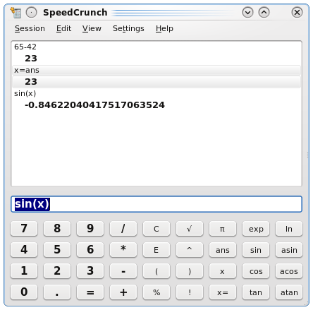

The Purpose of Qt
Cross platform applications built from one source
Builds native applications with native look and feel
Easy to (re)use API, high developer productivity, openess, fun to use
Notes:
The main purpose of Qt is its cross platform abilities, i.e. to create one source that can be compiled for all platforms.
The result should look, feel and simply be a native application.
Qt also strives at a intuit, easy to use and easy to re-use API. High developer productivity. Openess. Fun to use tools.

Slide 7

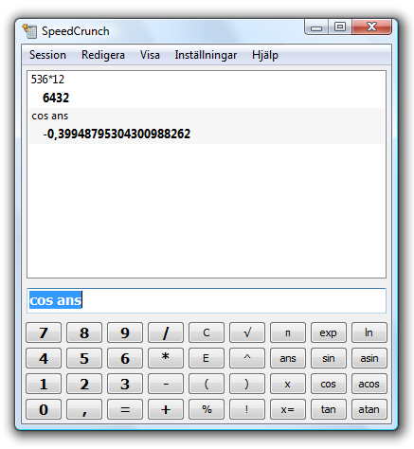
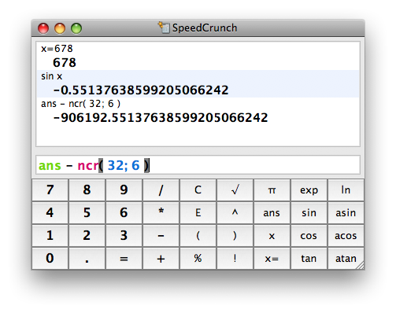
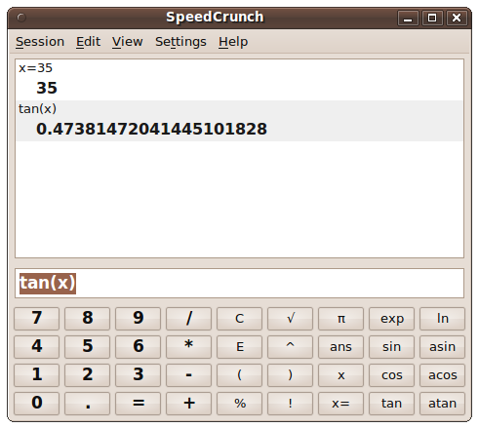
Desktop target platforms
Windows
Mac OS X
Linux/Unix X11
Notes:
Qt is available for all major desktop platforms.
Windows XP/Vista/7 are officially supported
OS X, latest version of Qt supports at least down to 10.3 (10.4 or later is required for development)
Linux/Unix with X11, i.e. not tied to Linux. Official support for Linux, AIX, HPUX, Solaris. Community support for FreeBSD, OpenBSD, NetBSD, etc.
Notice that the X11 support is not focused to deploying KDE on all desktops. Instead, Qt aims to integrate as a native part of all desktops, including Gnome.

Slide 8

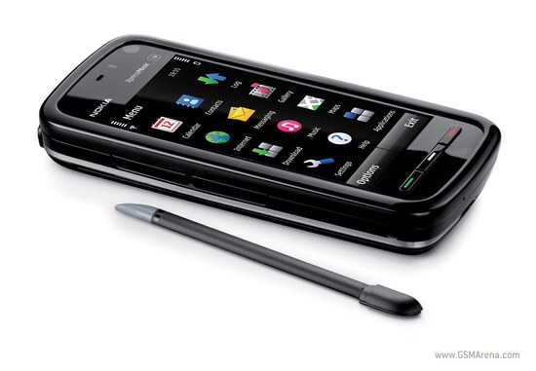
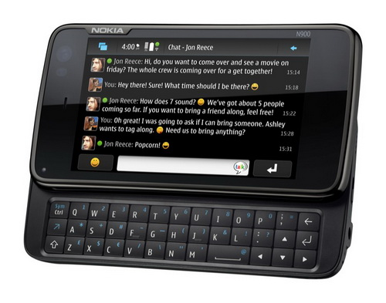
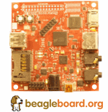
Embedded target platforms
Windows CE
Symbian
Maemo
Embedded Linux
  Direct framebuffer access
Notes:
Qt is also available for a number of embedded platforms.
Windows CE, versions 5 and 6.
Symbian S60, well tested with 3.1, 3.2 and 5.0.
Maemo, so you can use it on your N900 tablets
Embedded Linux, using the framebuffer directly, i.e. no X11 and a smaller footprint. Can accelerate on some platforms. A nice example is the beagleboard.
Tier 3 platforms: QNX, WxWorks. Supported by partner companies.

Slide 9



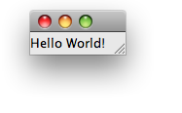
Hello World
Notes:
Walkthrough
The target of the project
This will be the starting point of the exercises for this lecture.

Slide 10
Hello World
#include <QApplication>
#include <QLabel>
int main( int argc, char **argv )
{
QApplication app( argc, argv );
QLabel l( "Hello World!" );
l.show();
return app.exec();
}
Notes:
Walkthrough
The entire source, focus on:
- simplicity
- small code

Slide 11
Hello World
#include <QApplication>
#include <QLabel>
int main( int argc, char **argv )
{
QApplication app( argc, argv );
QLabel l( "Hello World!" );
l.show();
return app.exec();
}
Notes:
Walkthrough
Focus on includes. All Qt classes are included by name, compare with iostream, etc. No “.h” ending, capitalization.

Slide 12
Hello World
#include <QApplication>
#include <QLabel>
int main( int argc, char **argv )
{
QApplication app( argc, argv );
QLabel l( "Hello World!" );
l.show();
return app.exec();
}
Notes:
Walkthrough
One QApplication object, drives the application, manages global settings.
There must always be a QApplication object.
You can always access the QApplication object through the qApp pointer. You can look at this as a singleton, but the instantiation must be made explicitly from the main function.

Slide 13
Hello World
#include <QApplication>
#include <QLabel>
int main( int argc, char **argv )
{
QApplication app( argc, argv );
QLabel l( "Hello World!" );
l.show();
return app.exec();
}
Notes:
Walkthrough
QLabel, is a widget. The text is passed to the constructor before the widget is shown.
Elaborate, everything is built from widgets. Widgets can be labels (as here), buttons, sliders, group boxes, windows, etc.
As the label does not have a parent widget, i.e. it is not contained by another widget, it is a top-level widget. This means that it will result in a new window that is decorated by the native window manager.

Slide 14
Hello World
#include <QApplication>
#include <QLabel>
int main( int argc, char **argv )
{
QApplication app( argc, argv );
QLabel l( "Hello World!" );
l.show();
return app.exec();
}
Notes:
Walkthrough
Calling exec start the event loop. This gets everything running.
The event loop ends when last window closes (can be turned off).
Having started the event loop, you must change mind-set. Everything from here on is event driven, be it user interaction (keys or mouse), network or timer.

Slide 15
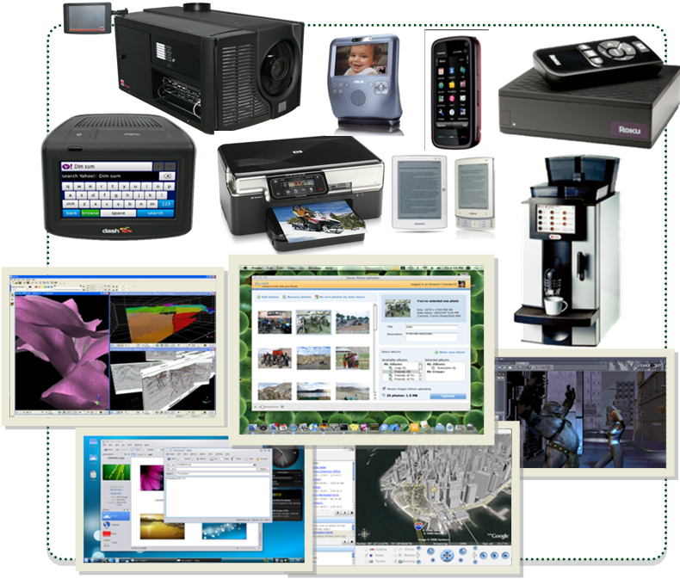
Where is Qt used?
Notes:
Legend: Devices and Screenshots
(from top left)
• Dash Express by Dash Navigation, Inc.
• Digital cinema projector by Barco
• Asus Skype Phone
• Dash Navigation Device
• Samsun eReader
• HP Photosmart Web-enabled printer
• Nokia 5800 Xpress Music
• Roku set top box
• 3DMove by Midland Valley Exploration Ltd.
• Photo Uploader application by Hyves
• HGZ Kaffemaschinen
• HP Photosmart Printer
• KDE 4 desktop showing Dolphin and KMail
• Google maps application
• Daz3D by Daz Productions
Details on these and other Qt-based applications and devices is available at http://qt.nokia.com/qt-in-use/.

Slide 16

Where is Qt used?

Slide 17
Commercial and Open Source
LGPL – free
  Your application can be open or closed
  Changes to Qt must be fed back to the community
GPL – free
  Your application must be open
  Changes to Qt must be fed back to the community
Commercial – costs money
  Your application can be closed
  Changes to Qt can be kept closed
Notes:
As you could see in the former slide, Qt is present in both commercial, closed source, software, as well as in free, open source, software.
Historically, Qt has been dual licensed as Commercial and GPL, i.e. if you close your source, you will have to pay.
However, since Nokia's acquisition, the top priority is to attract users. Thus, the LGPL license was added.

Slide 18


The history of Qt
1991 – Haavard Nord and Eirik Chambe-Eng begin to develop what will be Qt supporting X11 and Windows
1994 – The company Trolltech was formed
1996 – The KDE project was
started by Matthias Ettrich
(now works for Nokia Qt
Development Frameworks)
Notes:
Qt development started in 1991 byt Haavard Nord and Eirik Chambe-Eng.
Original version supported X11 and Windows.
In 1994, the company was formed. Originally named Quasar Technologies, then Troll Tech and finally Trolltech.
In 1996, Matthias Ettrich started the KDE project. Matthias now works as lead software engineer for Qt.

Slide 19

The history of Qt
2001 – Added support for Mac OS X
2005 – All platforms released under GPL
2008 – Nokia acquires Trolltech
2009 – Support for S60
Notes:
In 2001, OS X, is added as supported desktop environment. Anecdote: there was actually an experimental support for OS 9 in the Qt 3 days.
During the years, different platforms were released as GPL, and in 2005 all platforms had that license.
Anecdote: Originally, Qt was freely available under the QPL (Qt Public License) which caused some to be upset and the launch of the Gnome project. As a response to this X11 was released under GPL in 2000. OS X was released under GPL in 2003 (XonX made it possible to use X11 on OS X at the time). Finally, in 2005, Windows was released as GPL.
In 2008, Nokia bought Trolltech.
2009, with the release of Qt 4.6, Symbian and S60 became a supported platform of Qt.

Slide 20
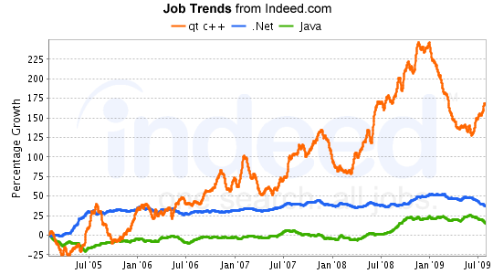
Qt Today
~840 classes
~180 developers working on Qt

Slide 21
Break

Slide 22
The Qt community
Qt is open source software, but the development is led by Qt Development Frameworks.
You can pay Qt for support.
You can use the community for support.
Or both...
Notes:
The Qt community is made up of two (overlapping) parts. The community of Qt users and the community of Qt developers (i.e. developers developing Qt).
The Qt development is led by Qt Development Frameworks, but it is free software with an open source, so anyone can start pulling in any direction.
For the users of Qt, the community largely works as a support institution (but also a social context and source of inspiration.
You can pay for Qt support, or use the community, or even combine the two.

Slide 23
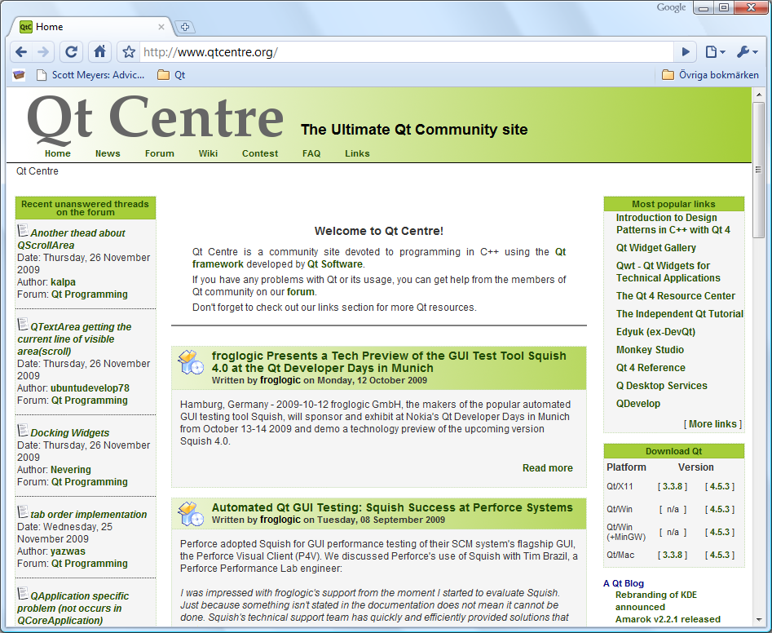
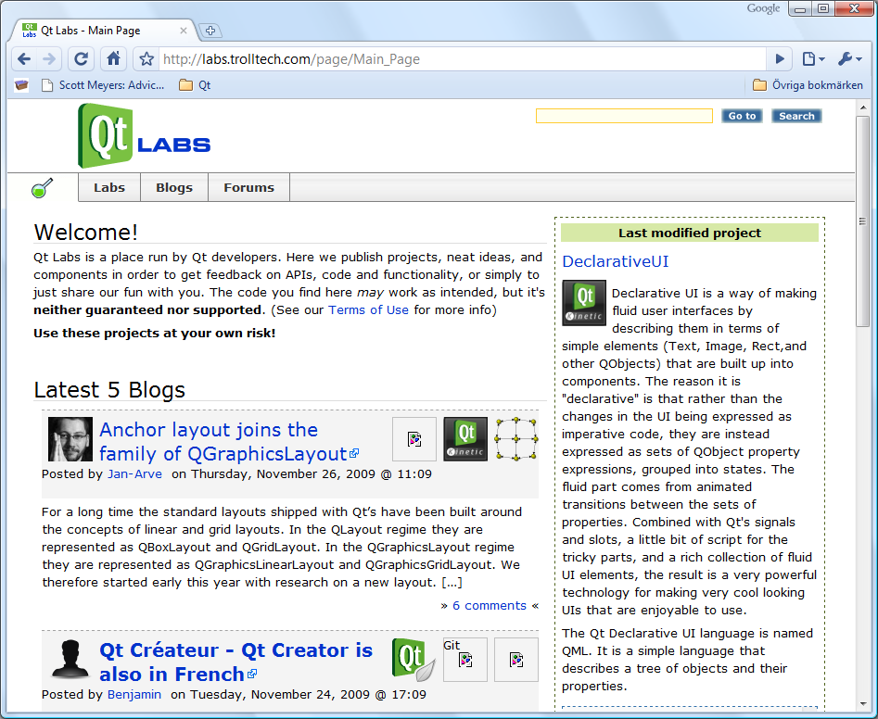
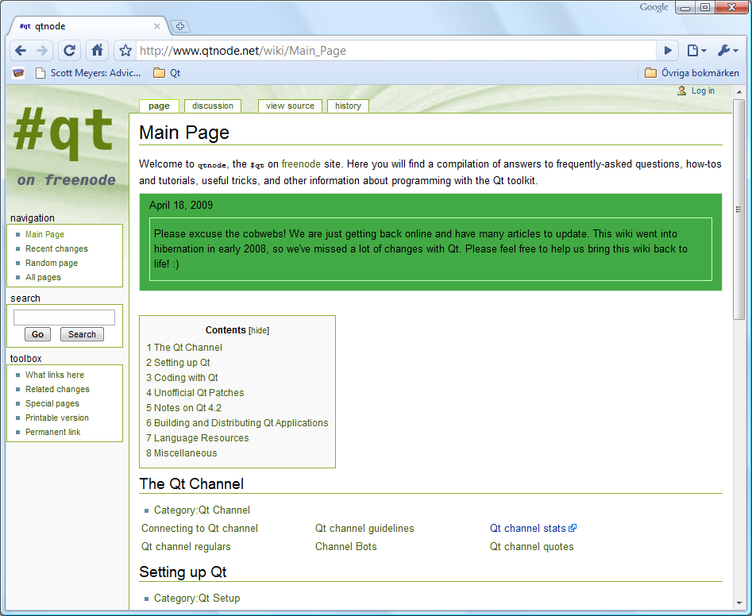
The Qt Community
QtCentre (www.qtcentre.org)
  forum, news, wiki
Qt labs (labs.trolltech.com)
  developer blogs, research projects
#qt at freenode
  IRC channel, has wiki at qtnode.net
Mailing lists (lists.trolltech.com)
  Qt-interest (still very active)
Notes:
This is just a small portion of the sites available.
These are all English speaking sites, localized versions are available, for instance:
TODO
The Qt documentation also points to a number of community sites.

Slide 24

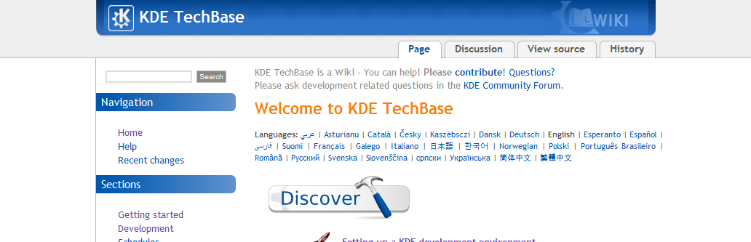
The KDE Community
The KDE project has been built on Qt
KDE TechBase (techbase.kde.org) wiki
+
=
Notes:
Mentioning the Qt community without mention KDE is wrong. The KDE project is the biggest user of Qt.
KDE hosts forums, wikis, IRCs, etcetera
One of the central starting points would be the KDE TechBase. It points to many other resources.

Slide 25
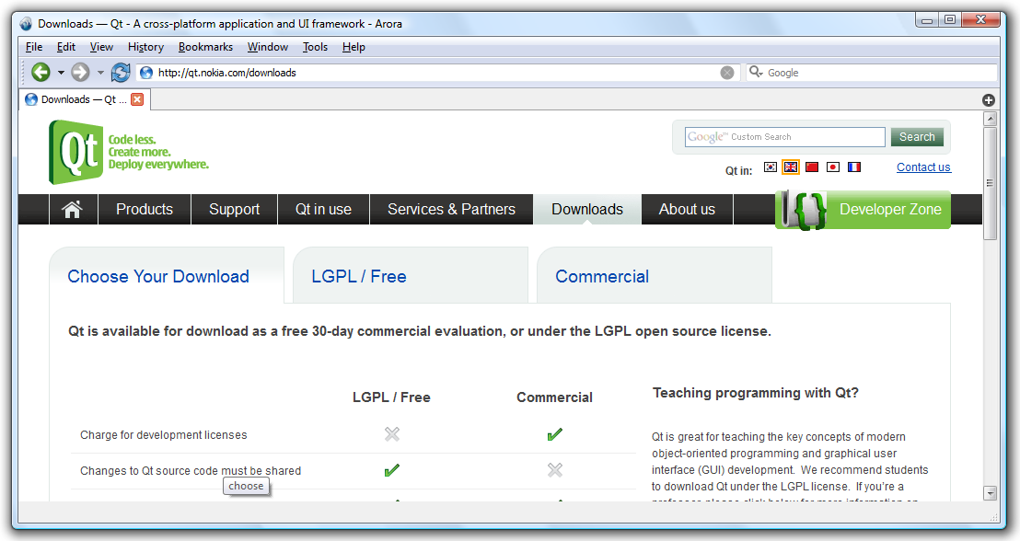
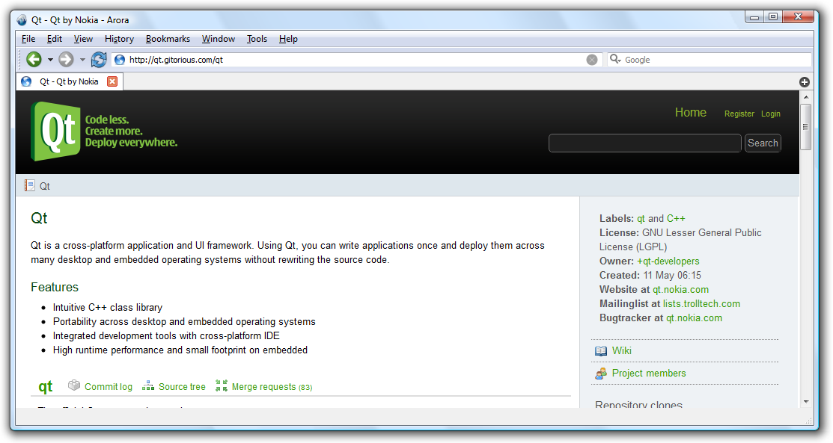
Getting Qt
Installers and snapshots are downloaded from
qt.nokia.com/downloads
Bleeding edge source trees are located at
qt.gitorious.com
Notes:
You can get Qt from two locations. Either you visit the Qt site and simply download a snapshot.
This can be either an official release, a tech preview or beta software. Qt is released both early and often.
If you want to have access to the bleeding edge of Qt, you can visit Qt at gitorious. Here you can take part in the ongoing work on the next version of Qt, as well as different research branches and such.

Slide 26

Getting Qt
The easiest way to get started is to download the Qt SDK. It contains
  Qt headers and documentation
  Pre-built Qt libraries and tools
  The QtCreator integrated development environment
Notes:
The easiest way to get started is to download the Qt SDK. It contains all the things needed to get started developing with Qt.

Slide 27


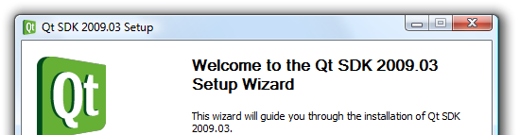

Windows Installation
Download the Qt SDK for Windows
Run the downloaded installer
Click through the installer
Start QtCreator from the start menu
Notes:
The windows installer is an ordinary installer.
If choosing custom paths, it is wise to choose a path without spaces in it, as this can confuse the build system in some cases.

Slide 28


Mac OS X installation
Download the Qt SDK for Mac OS X
Run the downloaded installer package
Click through the installer
Start QtCreator from the Finder
Notes:
Installation should be straight forward.

Slide 29
X11 installation
If possible, use the package manager from your distribution
(K)ubuntu – qt-sdk from universe
Debian – qtcreator
OpenSUSE – qt-creator
Gentoo – qt-creator
Arch Linux – qt qt-doc qt-creator
...
Notes:
Most Linux distros will package the Qt SDK, or at least Qt development packages and QtCreator (separately).
If possible, use those packages, as they are adapted and setup to your distribution's need.
However, these packages can be slightly outdated, so make sure that you are using Qt 4.6 or later.

Slide 30

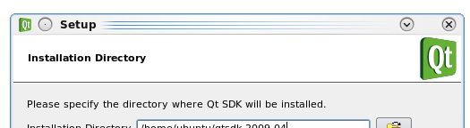
X11 Installation
Download the Qt SDK for your Linux version
Make the installer executable
Run the installer and click your way through it
Start QtCreator from your desktop or menu
chmod u+x qt-sdk-linux-*.bin
Notes:
If you want to install Qt using the installer, first, download the SDK for your Linux version.
To determine what you are running, use name -u and see if the end of the returned line contains ia64 or x86_64.
To be able to run the installer, you must make it runnable. Accessing it from a FAT formatted filesystem (a USB dongle) could make it runnable, otherwise you must either right-click on it and turn on the x-bit (eXecutable) using a file property dialog, or you can use chmod.
When all these steps have been completed, just run the installer and start QtCreator. The installer places an icon on the desktop and in the program menu, usually under the Development category.

Slide 31
Demonstration
Notes:
Please refer to the separate demonstration script.

